Slide 1
Student-Landlord Lease Advisor
Your one-stop solution to simplify
leases and agreements

Slide 2
Table of contents
01
02
03
04
05
06
Introduction
Objective
Application Workflow
Architecture
Setting Up the Environment and GUI
Embedding PDFs and Creating Vector Store

Slide 3
Table of contents
07
08
09
10
11
12
Adding Memory and Running the Application
Project Demonstration
Code Explanation
Key Learnings
Future Scope/Modifications
Conclusion

Slide 4
01
Introduction

Slide 5

Introduction
Overview of the Problem:
Lease agreements often contain legal jargon and lengthy clauses, leading to confusion.
Students face challenges in understanding their rights and responsibilities.
Landlords need a streamlined way to explain key terms without misinterpretation.
Unique Value Proposition:
Combines natural language processing with AI-driven tools to simplify lease agreements.
Offers tailored advice based on user queries, ensuring clarity and accuracy.

Slide 6
02
Objectives

Slide 7
Objective
Goal Statement:
"Develop an AI-powered chatbot to navigate and explain lease agreements easily.“
Reduce the need for external legal consultation for basic lease clarification.

Slide 8
03
Application Workflow

Slide 9
Application Workflow
Process Diagram :
User uploads a lease document
System analyzes and extracts text using LangChain.
AI chatbot generates tailored responses to user queries.
Users receive step-by-step guidance on lease provisions.
Enhanced Explanation:
Add annotations to the diagram explaining each stage.
Highlight real-world scenarios, e.g., "What does the security deposit clause mean?"

Slide 10
04
Architecture

Slide 11
Architecture
Frontend
Backend
Data Flow
Built with Streamlit for an intuitive and responsive interface.
Offers a clean design prioritizing user experience.
Text processing powered by LangChain.
Embedding creation using OpenAI and HuggingFace.
Vector storage and retrieval using FAISS/Pinecone for rapid response.
Lease documents converted into embeddings for efficient search and retrieval.
Context-based responses generated dynamically.

Slide 12
05
Setting Up the Environment and GUI

Slide 13
Setting Up the Environment and GUI
Tools and Libraries
Python
Core language for
development.
Streamlit
GUI framework for a seamless user experience.
FAISS
Optimized vector database for embedding retrieval.
LangChain
Foundation for text analysis and chatbot capabilities.
OpenAI API
Enhances the chatbot’s language understanding.

Slide 14
Setting Up the Environment and GUI
Tools and Libraries
Python
Core language for
development.
Streamlit
GUI framework for a seamless user experience.
FAISS
Optimized vector database for embedding retrieval.
LangChain
Foundation for text analysis and chatbot capabilities.
OpenAI API
Enhances the chatbot’s language understanding.

Slide 15
Key ideas in market opportunity
Research new markets
Innovative solutions
Analyze existing customer needs and identify gaps in the market to find new opportunities
Utilize technology and customer feedback to come up with novel solutions that meet your customer’s demands or needs
Stay ahead of trends
Seasonal spikes
Monitor changes in the marketplace, such as shifts in consumer behavior or emerging technologies, to stay competitive and capitalize on new opportunities and trends
Identify times of year when demand for certain products may spike, such as holidays or special occasions, and use these times to target customers or maximize sales

Slide 16
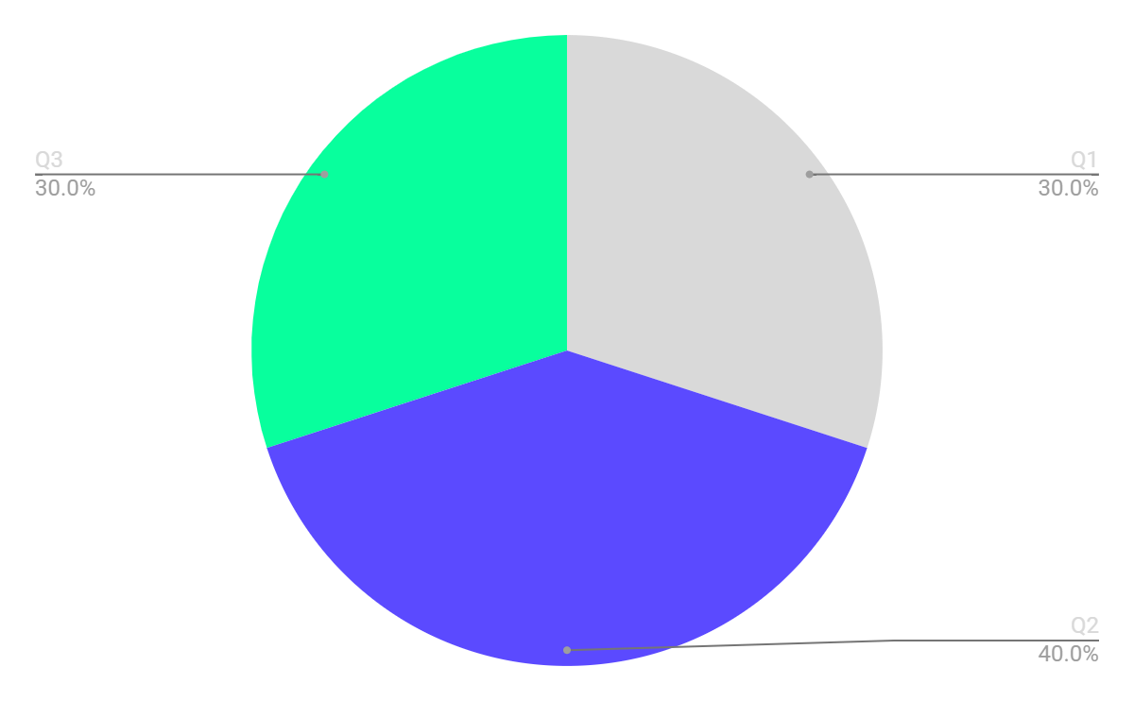
Revenue by quarter
Q1
Q2
Q3
January - April
May - August
September - December
Follow the link in the graph to modify its data and then paste the new one here. For more info, click here

Slide 17
Competition comparison
 | Features | Value | Pricing | Trial | Competence | Share
Company A | Fuel economy | Special offers | $23,000 | No | Low | 8%
Company B | Design | Reliability | $27,000 | No | Low | 5%
Company C | Performance | Repairs | $30,000 | Yes | High | 20%
Company D | Safety features | Marketing | $24,000 | No | High | 22%
Company E | Technology | Customers | $32,000 | Yes | Low | 10%
Company F | Comfort | Best prices | $15,000 | Yes | High | 30%
Company G | Customization | Brand name | $45,000 | No | Low | 5%

Slide 18
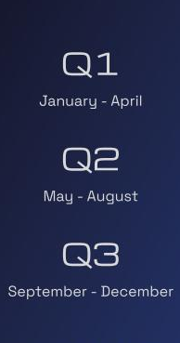
Product infographic
Visuals
Features
Showcase the design of your product
What makes you product unique?
Price
Users
Share the cost and price with investors
Speak about the target audience
Availability
Updates
When is the product expected to be ready?
Do you plan on updating it?

Slide 19
Timeline of your presentation
Provide a brief overview of the pitch deck’s content
Engage the audience with a compelling introduction
Identify the customer’s pain points and challenges
Describe how your product or service can solve the problem
End with a clear and concise call to action
Explain your financial needs and briefly outline your funding allocation
Analyze the target market size, growth potential, and competition briefly
Highlight the unique value proposition and benefits of your specific solution

Slide 20
Market size overview
$100M
$20M
$5M
Outer circle
Middle circle
Inner circle
Include the total size of the market, which represents the entire potential customer base for the product or service
Identify the target market for the product or service, which may be a subset of the total market. This could be based on factors such as demographics, geography, or specific needs
Indicate the current market size, which represents the portion of the target market that the company has successfully captured

Slide 21
Roadmap infographic
Initiative | Objective | Jan | Feb | Mar | Apr | May | Jun | Jul | Aug | Sep | Oct | Nov | Dec
Understanding | Analyze and understand the needs of your target audience
Conduct research | Research existing products in the industry and analyze how successful they are
Brainstorm ideas | Generate ideas based on user feedback and research findings
Develop a prototype | Create a basic version of the product to show investors
Test for usability | Put the prototype through rigorous testing processes to ensure that it meets user requirements
Analyze feedback | Analyze feedback

Slide 22
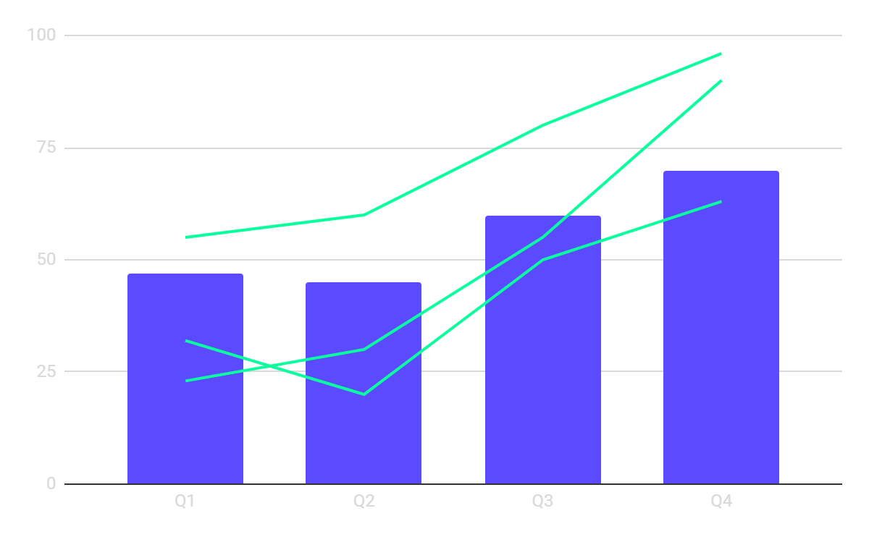
KPI dashboard
KPI | Current Value | Target Value
User satisfaction | 4.5/5 | >4.5/5
Response time | 2.3 seconds | <3 seconds
Error rate | 0.8% | <1%
Conversation rate | 15% | >20%
Retention rate | 80% | >75%
Feedback ratings | 4.7/5 | >4.5/5
$4M
$100M
$5K
Revenue
General costs
Benefit
Follow the link in the graph to modify its data and then paste the new one here. For more info, click here

Slide 23
Resources
Did you like the resources on this template? Get them for free at our other websites:
Vectors
Gradient data privacy facebook template
Gradient sale instagram story collection
Photos
Close up hand holding smartphone

